Slide 1
NAU CubeSat Capstone Team
Preliminary Design
Review
Richard Campos: Team Leader
Zackary Retzlaff: Client Contact
Jacob Belin: Budget Liaison
Jacqueline Fonseca: Website Designer
Notes:
~title slide, introductions

Slide 2
Program Description
The proposed effort will design a testing fixture that will securely attach a 12U CubeSat to an Air Bearing Stand while relocating the center of gravity to the center of rotation.
The design must:
Refocus Center of Gravity
Limit Tilt Degree
Be Adjustable in Three Axes
Be Adjustable to Different Payloads
Notes:
For this project the teams goal is design a testing fixture for a 12U CubeSat that will attach to an Air Bearing Stand while also being able to find and relocate the center of gravity to the desired position. As of now the clients are just using a solid surface to attach the CubeSat to during testing procedures. Designing the new fixture to be able to attach to an air bearing stand will allow for the clients to generate more accurate test results and mimic what the CubeSat will go through while it is in space. A few of the design criteria that the fixture must accomplish is that the design must refocus the center of gravity to the center of rotation, must limit tilt degree to 35 degrees, must be adjustable in all three axes, and must be adjustable to different payloads.

Slide 3
PDR - Agenda
Administration
  Meeting minutes
  SRR Action Items
  Action Items Form
  PDR - Entrance/Exit Criteria
Integrated Master Schedule
Mission Requirements
Mission Concept of Operations
System Level Design/Selections
  System Level Design
  Subsystem Design
    Electrical / Power
    Software
    Mechanical
  Subsystem Interface Documents
    Hardware, Electrical, Software, Test, & External
Requirements Verification Matrix (RVM)
Assembly, Integration, & Test (AI&T)
  Test Plan
  Support Equipment
  Functional Testing
Risk Assessment & Mitigation Plan
Customer Furnished Equipment Required
Action Item Review
PDR - Exit Criteria
Conclusions
Notes:
~agenda for what will be gone over in the presentation/report

Slide 4

SRR Action Items
ID# | Action | Satisfied
SRR-001 | Supplier clearly demonstrates an understanding of the system requirements consistent with the ICD and draft CDD.
SRR-002 | System requirements are assessed to be verifiable.
SRR-003 | System Requirements have been synthesized into conceptual architectures.
SRR-004 | System conceptual architecture alternatives are developed and assessed in the context of engineering trade space, technical requirements, system specification, risks
SRR-005 | The preliminary system conceptual architectures support implementation of operational concepts, interoperability objectives, and system and external interface requirements.
SRR-006 | The program schedule is executable with an acceptable level of technical and cost risk.
Notes:
These are the main components from the SRR that the team discussed earlier in the semester. Each of these items has been completed by the team and we are now moving forward in the design process. The system requirements refer to the engineering requirements outlined by the team in previous presentations and later on in this report. The team has been working extensively on refining these and have now prepared to start the final design process. The preliminary concepts are the sub-functions that the team will outline later on in the presentation. These sub-functions are the essential functions to the providing our clients with the best possible product.

Slide 5
PDR Entrance Criteria
Entrance Criteria | Satisfied
Completion of the System Requirements Review (SRR).
Adjudication of the SRR Action Items.
Requirements are clear, documented, verifiable, and flowed down to levels needed to accomplish the design, analysis, and test tasks.
All major design elements are baselined to meet the project requirements are ready to present.
Completion of Integrated Master Schedule.
The test strategy is documented.
Notes:
In order to start the Preliminary Design Report process, the team had a checklist to follow. The team completed a review of the SRR earlier in the semester and have focused on completing these SRR action items since this gave the team a good outline for the remainder of the project. The integrated master schedule is the Gantt Chart which will be presented in a few slides. This chart illustrates the team's goals for the remainder of the semester as far as completing action items goes. It will give a broad outline on what the team seeks to accomplish in the coming weeks. The team will then break these tasks down into smaller tasks in order to finish these effectively and in a timely manner.

Slide 6
PDR Exit Criteria
Exit Criteria
ACTION ITEMS: All PDR Action Items have been identified with closure due dates defined and dispositioned by PDR Panel. There are no open action items that are liens to PDR closure.
REQUIREMENTS: PDR panel assesses that the Requirements Baseline has been established, documented, and approved.
DESIGN: PDR panel assesses that the preliminary design has been established, documented, and approved and has sufficient margins for proceeding with acceptable risk.
PROGRAM EXECUTION: PDR panel assesses that the program is executable within existing budget while maintaining acceptable cost, schedule, and technical risk.
EXTERNAL FACTORS: PDR panel assesses that there are no significant issues outside the scope of the contract that must be incorporated post-PDR.
METRICS: PDR panel assesses the program to have the correct metrics in place to track the technical, cost, and schedule efforts to ensure contract and performance compliance going forward into the next phase.
OBJECTIVE EVIDENCE: PDR panel assesses the Objective Evidence and PDR presentation provides confidence in preliminary design maturity and sufficient margins for proceeding with low risk.
PATH FORWARD: Path forward to CDR provided and coordinated with the Customer Lead – As a result of successful completion of the PDR, the design-to baseline is approved. A successful review result also authorizes the project to proceed into implementation and toward final design.
Notes:
In order to finish the PDR, the team must be approved by the panel to move forward. These are the things that will be discussed throughout the PDR and then the panel will determine if the team is set to move forward at the end. It is very important that the team meets all of these expectations so the team can move forward in the design process.

Slide 7
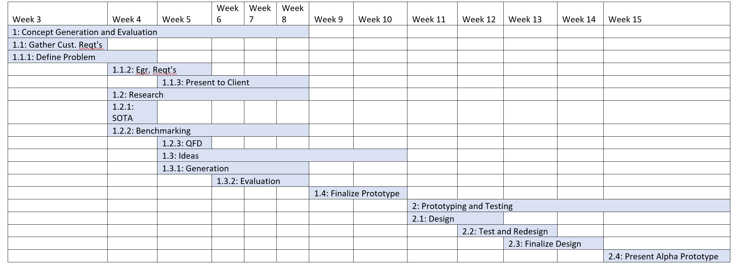
Integrated Master Schedule (IMS)
Richard
Notes:
The Gantt chart that was made by the capstone team reflects the work that has been done during the semester and the tasks to be accomplished in the latter half. The team hopes to finalize the design in the two weeks following Spring break in order give us ample time to work out aspects of our design in finer detail. This would give the team ample time between semesters to construct and test the fixture so that by the time it is presented to our clients, the design will suit their needs to the fullest extent.

Slide 8
Mission Requirements (Engineering Requirements)
ID | Name | Description
1 | Weight | 24 ± 2kg
2 | Limit Tilt | < 35°
3 | Magnetism | Minimal (depends on final actuator)
4 | Movement of CG | 50 mm max on x, y, and z axes
5 | Rotation | 360°
6 | Adjustable Payloads | YES/NO
7 | Volume | < 8 m^3
8 | Magnetism | YES/NO
Richard
Notes:
These engineering requirements were determined by meetings with our client and stakeholders, discussing their specific needs. The project description gave the team a good outline on what to focus on for the requirements of the project but the client made these more clear. The clients made sure that the team focused primarily on not including magnetism in our design concepts. This was a very difficult roadblock in the concept generation process since most of the motors, sensors, actuators, etc. the team wanted to use had some sort of magnetism. The clients also made sure the team focused on being adjustable in the z-direction since this requirement was not considered heavily by the team before the concept generation process began.

Slide 9
Requirement Variations Since SRR
Ensure design can adjust in z-axis
Ensure design can adjust to different payload sizes
Shift focus away from material properties
Notes:
The clients communicated specific engineering requirements to focus on when designing concepts for this project. The clients made sure the team focused on having the fixture be adjustable in the z-axis as well as adjustable to different payload sizes. At first, the team focused on material properties which General Atomics explained that the team should not be focused on that. This is primarily because the final deliverable for this project is a 3-D printed model of the fixture.

Slide 10
Concept of Operations
Reliable
Durable
Non-Magnetic
Limit Space
Limit Overall Weight
CubeSat Easily Installed and Removed
Simply and Effectively Secure CubeSat
Adjustable on all three axis
Compactible with Air Bearing Table
Refocus CG for Assembly
Does not fall off test stand
Notes:
The concept of operations comes from the customer needs discovered earlier in the semester from speaking to our clients as well as going over the project description. The team used the concept of operations to generate engineering requirements. These engineering requirements were mentioned earlier and these gave the team a good baseline on what to design for. In order to determine the weights of the engineering requirements, the team constructed a QFD, also called a Requirements Verification Matrix.

Slide 11
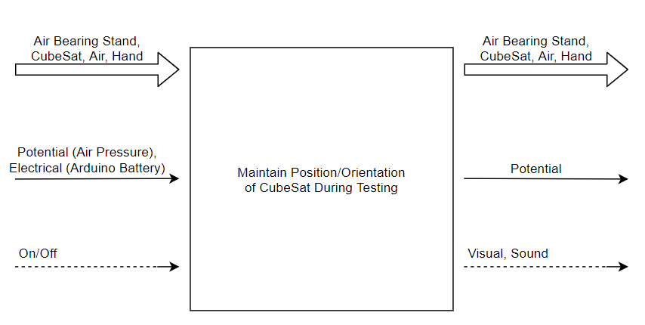
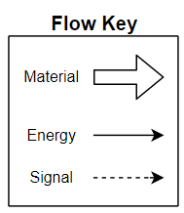
System Level Overview
Black Box Model
Notes:
The black box model shows the different types of flows that enter the device and leaves the device while it is used. For this design the main function of the device is to maintain position and orientation of the CubeSat during testing. The different flows that are shown in black box model are the material, energy and signal flows. For this specific device the materials going in and out are the air bearing stand, the CubeSat, air and a hand. The energy flows going in are potential and electrical, and the energy flow leaving is potential. The signal flow entering is just an on/off signal, and the signals leaving are visual and sound. The black box model is used in order to break down the flows of the device into the simplest version to focus on what the device must do.

Slide 12
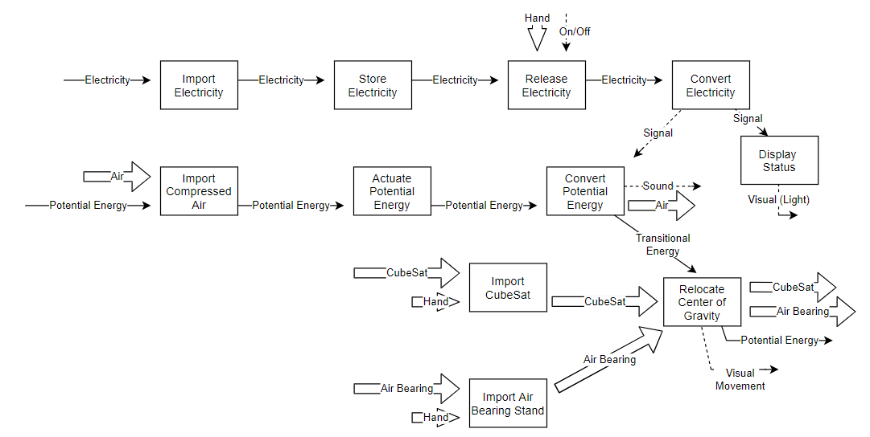
System Level Overview
Functional Model
Notes:
The functional model takes the different flows shown in the black box model and develops how the different flows travel throughout the device. The functional model also shows how the different flows are changed as it moves through the device. These two models combined help break down the functionality of the device and makes it easier to focus on the most important aspects of the design.

Slide 13
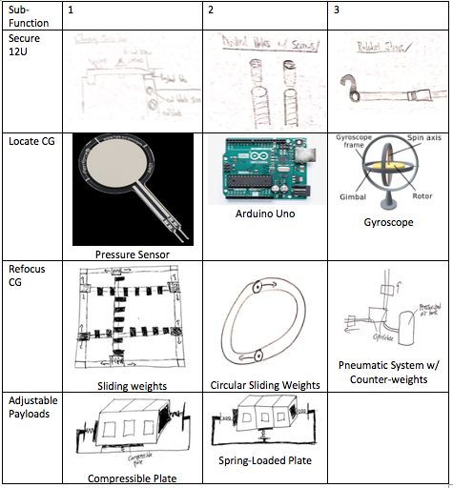
Subsystem Design: Morphological Matrix
Notes:
These were the main concepts for the four sub-functions the team designed for. The four sub-functions include: Secure 12U, Locate CG, Refocus CG and Adjustable to Payloads. The team will use the clamping mechanism outlined in a PDF received from GA to secure the CubeSat to the fixture. Also, the team opted to use the pressure sensors with an Arduino Uno in order to have a working program to locate the CG. The sliding weight mechanism is the top choice to refocus the CG amongst the team and the team is leaning towards a manually adjustable power screw to limit magnetism in the device. In order to adjust to different payloads, the team also determined to use either a compressible or spring-loaded plate to make the area smaller or larger for different CubeSat units.

Slide 14
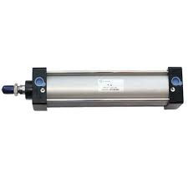
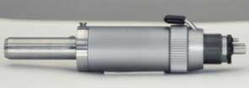
Subsystem Design:
Refocus CG
Pneumatic System
Pneumatic Cylinders
  Plenty of options on the market
  Easily used and installed
  Various sizes
  Will need multiple cylinders and valves
  Are not precise in the movements
Pneumatic Motors
  Options on the Market
  Precise Movement
  Reversible
  Will need multiple motors and valves
Tested by having design at predetermined angles/position
  Based on sensor data, actuators will refocus CG
  Verified with the use of hand calculations
Notes:
The idea for the device to complete the subsystem of refocusing the center of gravity is to use a type of pneumatic system that is attached to counter weights. The first type of pneumatic system to be used is utilizing a pneumatic cylinder. This system will have a counter weight attached to the end of the rod where the cylinder will extend and retract in order to move the weight, therefore balancing the fixture. Using cylinders for this device has a few pros and cons associated with this decision. The first pro is that there are many types of pneumatic cylinders on the market, of various sizes, and some being inexpensive. The second is that they are easily installed into the device and used. However, the cons are that their will need to be multiple different cylinders and valves in the system creating more magnetic flux. And one of the design criteria is for the magnetism of the device needs to be limited. The last con of using a pneumatic cylinder is that they are not precise in the movements. This would result in the issue of not being able to accurately relocate the center of gravity of the device. Therefore resulting in low safety of the concern of the fixture falling off of the air bearing stand.
The second option of using a pneumatic system is to use a pneumatic motor that is attached to a power screw with counter weights on it. The motor will twist allowing for the counter weights to move forward and backwards. This option also has a few pros and cons associated with it. The first pro is that there are options on the market that are various sizes. These device is more precise than a pneumatic cylinder and most of the motors are able to reverse the direction in which they rotate. However, the con for using this system is that there will need to be multiple motors and valves operating the system therefore increasing the amount of magnetic flux generated by the device.
For both options the way this subsystem will be tested is to set the fixture at a certain tilt and then will run the pneumatic system in order for the counter weights to be moved to their correct location to balance the device. These locations will be checked by hand calculations.

Slide 15
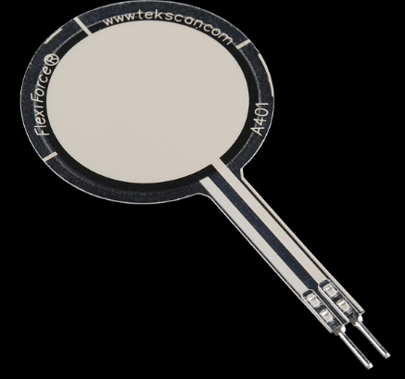
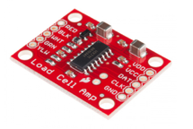
Subsystem Design:
Software (Locate CG)
Arduino
C++ programming software
HX711 Arduino Part
Force sensors
  Connected to each corner of the fixture
  Will read the force at each point and calculate CG
Code
  CG equations
  Geometry of fixture is implemented into this
  Determines method to relocate CG
Notes:
Arduino will be utilized in our project to locate the CG of the CubeSat and align it with the CG of the fixture. The team does not have to locate the CG of the fixture each time but will have to locate the CG of the CubeSat since the payloads are changing. The team is planning on using force sensors on each corner of the fixture in order to determine the weight distribution of the CubeSat. The team will incorporate a code to take data from the force sensors to locate the CG of the CubeSat. In order to do this effectively, numerous tests must be run in order to accurately determine the CG using the code created with Arduino.

Slide 16

Subsystem Design:
Software (Locate CG)
From Payload Specs PDF for 12U
Max/Min Center of Mass:
X-direction: -40mm to 40mm
Y-direction: 55 to 125mm
Z-direction: 133 to 233mm
Max Payload Depth:
Y-direction: 222.8mm
X-direction(+-): 199.7mm
Notes:
These payload speculations are directly from a document provided to the team by General Atomics. It gives the team a reference on the maximum and minimum centers of mass in each direction for the CubeSat. This is important in our project since the center of gravity of the fixture must align with the center of gravity of the CubeSat. This also gives the team maximum and minimum dimensions to construct a code in Arduino. This is helpful since the center of mass must not exceed these distances in each axis.

Slide 17
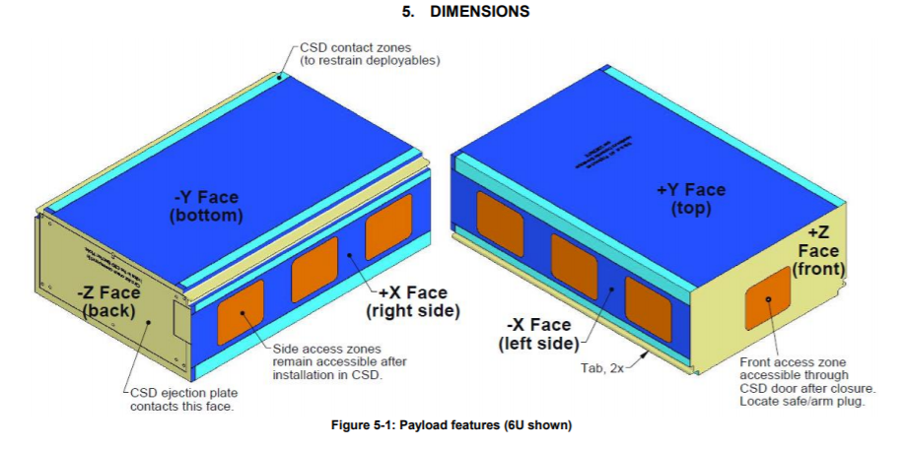
Subsystem Design:
Secure 12U
Tabs – secure CubeSat/payload to the CSD and increase accuracy for strength analysis.
Notes:
In a meeting with the client, our CubeSat team asked for any critical details from their present design to incorporate into our new design. The client and party iterated the tabs on the assembled CubeSat body should be utilized when considering how the CubeSat would connect to our device. General Atomics’ current design uses tabs that run along the length of the CubeSat assembly to append to other compatible hardware. The figure on the slide shows XYZ faces for the assembled CubeSat. General Atomics uses a toggle clamp for current testing procedures. The tab detail was reviewed by GA on multiple occasions, so it became a critical detail in our fixture design. The CubeSat needs and effective mechanism to secure the CubeSat to the fixture.

Slide 18
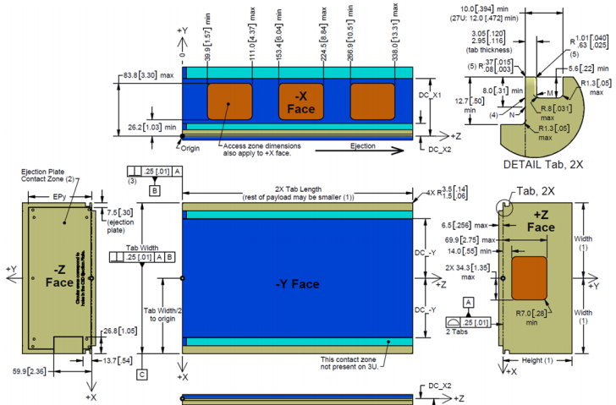
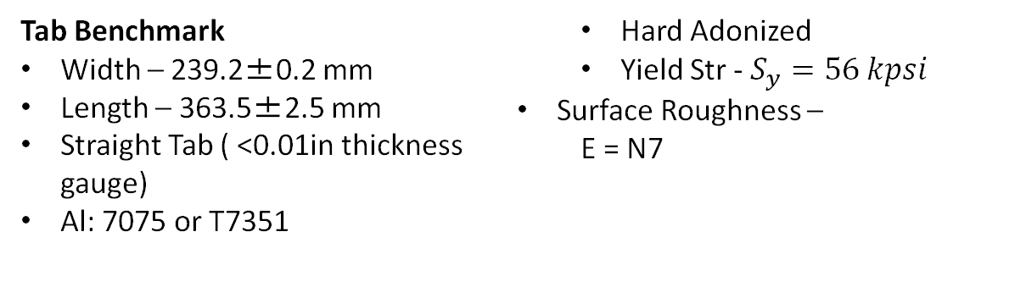
Subsystem Design:
Secure 12U
Tab Benchmark
Width – 239.2±0.2 mm
Length – 363.5±2.5 mm
Straight Tab ( <0.01in thickness gauge)
Al: 7075 or T7351
  Hard Adonized
  Yield Str - $S_{y}=56 kpsi$
Surface Roughness –
  Ε = N7
Notes:
The current tab specs for 12U CS follow as one tab with width (X dir.) is 239.2±0.2 mm and the length ( Y dir.) is 363.5±2.5 mm. A CubeSat assembly always has two tabs that interface with the canisterized satellite dispenser (CSD). Planetary Systems Corporation (PCS) specifies the tabs be made of hard adonized, aluminum (7075, T7351) to achieve yield strength, S_{y} > 56 kpsi. The surface of these tabs are designed for ε = N7 and is imperative the tab contact surfaces avoid holes, countersinks, or other features. A smooth surface ensures roller bearings go undisturbed during dispensing. Since PCS allows gaps in the tab length edges, a new securing mechanism must perform under these variations in contact surfaces. In addition to this variation, the tabs can be manufactured as a single solid plate or as two solid lengths which bolt to the CubeSat assembly. The selected tab design dampens vibrations more so than other clamping mechanism and gives this mechanism a large favor.
Ref:
Planetary Systems Corporation, “PAYLOAD SPECIFICATION FOR 3U, 6U AND 12U.” .

Slide 19
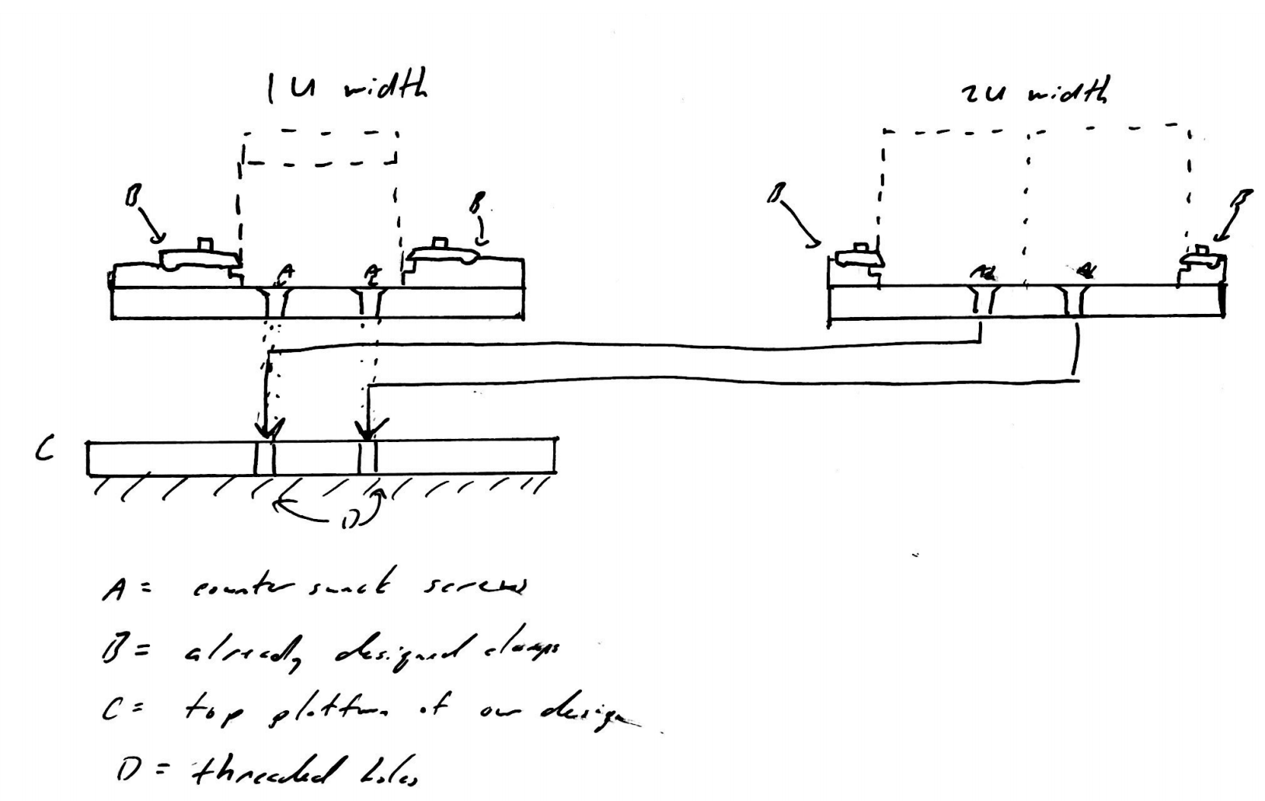
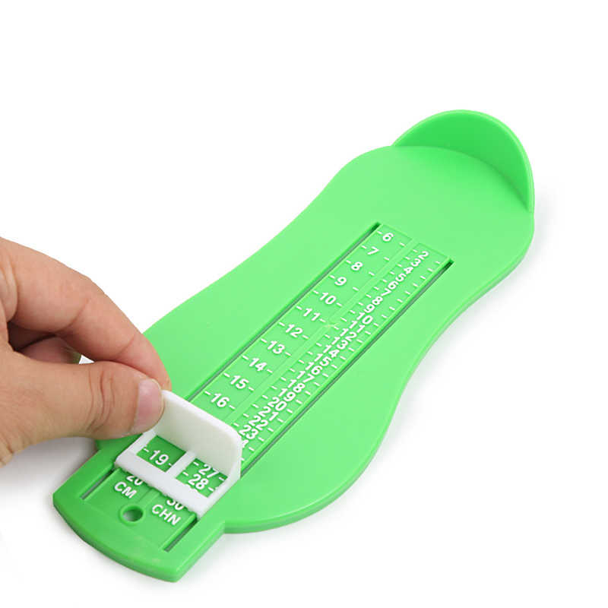
Subsystem Design:
Adjust to Payloads
1) Adjustable variable length
2) Change of base
Option 1
Option 2
Richard
Notes:
These two options show different methods on how the team plans to go about having the fixture adjust to different payload sizes. It was determined that only two widths were necessary as the 12U and 6U both play flat onto the fixture with a width of 2U/ The first option shows that a sliding mechanism adjusted by hand can be utilized easily to change the width. One advantage this option has is that it is easy to use and requires less time to operate. Unfortunatly due to the slightly larger amounts of moving parts, it would have a shorter fatigue life. The second option has our design utilize different platforms on which the CubeSat will rest on. These will be removable and each will be tailored to the different CubeSat dimensions. While this design does require more time to utilize, it does seem the more stable of the two options.

Slide 20
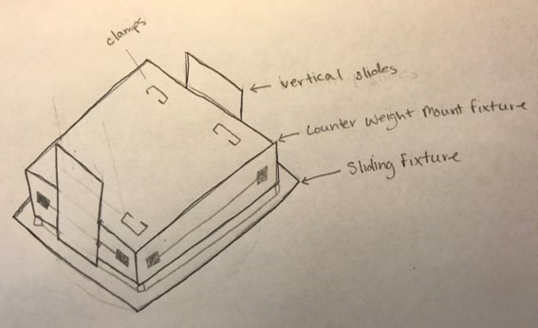
Final Design Sketch

Slide 21
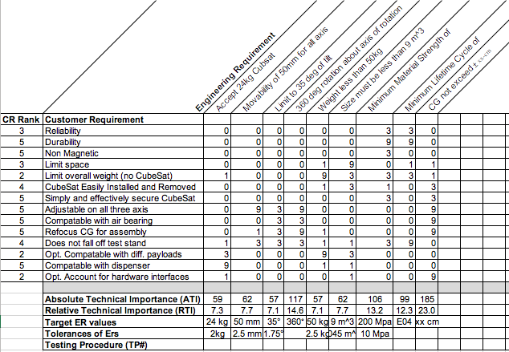
Requirements Verification Matrix (RVM)
Notes:
The Requirements Verification Matrix is the Quality Function Diagram (QFD) created earlier in the semester. This gives the weights of each engineering requirements. When the weights are calculated, this gives the team a better idea on what design parameters are more important than others. After speaking with our clients, the team determined the 360 degree rotation, CG constraint and lifetime cycle to be most important. The team determined material strength to be less important after speaking with our client as mentioned previously in the presentation.

Slide 22
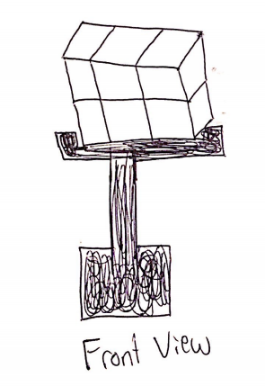
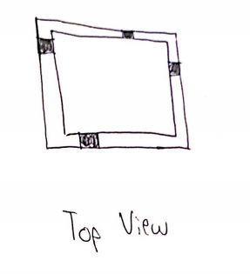
AI&T: Test Plan & Flow: Relocate CG
Stationary Test on Fixture
The team will attach the fixture to a flat plate rather than the air bearing assembly
Will use counter-weights to relocate the center of gravity manually
Will be a replica of weight instead of just mass since gravity is negligible when using the air bearing system
Notes:
In order to relocate the center of gravity of the fixture to align with the center of gravity of the CubeSat, the team must do testing. Without access to the air bearing GA is using for this project, the team will test the fixture by attaching it to a flat plate. Then, a cube will be clamped onto the fixture and the team will locate the center of gravity using Arduino code. After locating the center of gravity, the team can then use a method to relocate the center of gravity based on the coordinates given by the Arduino. These force sensors must be highly accurate in order to locate the center of gravity precisely. This test will give the team a good idea about how the fixture will operate on an air bearing stand without actually having access to an air bearing.

Slide 23
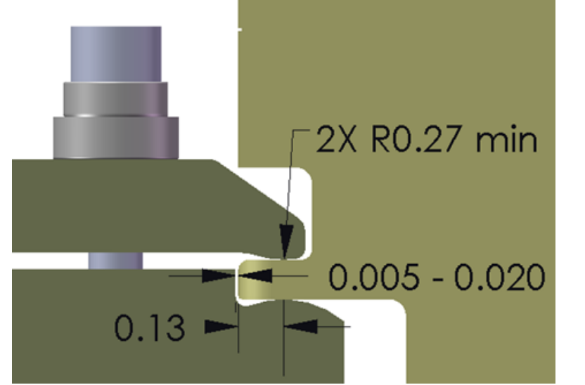
AI&T: Test Plan & Flow: Secure 12U
From engineering drawings, clamp can be manufactured on campus
CubeSat cage can be printed in house
Securement options can be prototyped
Same test as relocating CG
Notes:
Since the client had a design in place for securing the CubeSat onto the testing platform, the capstone team though it best to utilize this design. This was done with the thought that it would reduce the workload for the team and that it was of no use to design a feature which already works as needed. It is also fortunate that the design is easy to manufacture for testing purposes. To maximize our time, the team plans to run the tests for the subfunctions simultaneously.

Slide 24
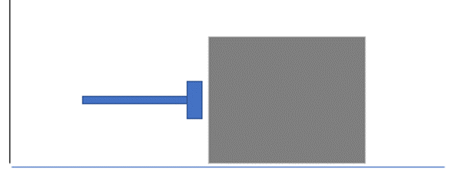
AI&T: Test Plan & Flow: Pneumatics
Assess cylinder performance and relate pressure input to piston displacement
Determine work energy needed to displace piston from min, intermediate, and max distances.
Configure coordinates for several orientation cases and use Arduino to determine work energy, displacement, charge pressure, and actuate valves
Verify distances correlate to work energy input to cylinder and to distances required for that simulation
Notes:
The CubeSat fixture has a low tolerance for relocating the center of gravity. Per this requirement, it is key to determine the performance of the pneumatic devices going into the design. The pneumatics will be purchased from a vendor and manufacturers specifications will be analyzed to determine pressure limits, max/min piston displacement, and other pertinent specs. When the devices are evaluated, a flat benchtop will be prepared to hold the pneumatic device stationary with the actuator appended to a known mass. The work energy required to move the mass a certain distance will be calculated by hand with known conditions and assumptions. The work energy required will be set equal to the output work energy from the pneumatic device. The pneumatics' work process and associated equation will be solved to determine the final and initial states to create the hand-derived energy. When these states are determined, the pneumatic will be actuated with the corresponding states. The displacement of the mass will be analyzed to verify the work in and work out produce the action needed. If the desired displacement is not achieved, the pneumatic device will need to be statically calibrated under first order response assumption.
Once calibration is complete, the device will be connected and synched to the Arduino program for the fixture. The Arduino and pneumatic will be assembled to a tertiary prototype. With this prototype, the assembly will undergo a static simulation to tune communication from the Arduino program to the pneumatic hardware. The assembly will be oriented so the pretest-CG coordinates are known and the assembly will attempt to relocate the CG with the calibrated pneumatics and Arduino program. These post-test coordinates will be compared to the expected CG coordinates. Process will be repeated for different orientations and if target performance is achieved, the prototype will test under a dynamic simulation where the assembly is re-orientates continuously.

Slide 25
AI&T: Test Plan & Flow: Stationary/Precision Location
Design will be placed at different angles/positions
Onboard sensors will calculate said angles/positions
Data will be compared to what angle/position is certain to be

Slide 26
Preliminary Support Equipment Assessment
Prototype securement options
Prototype fixture
In house manufactured air bearing table
Arduino UNO with applicable sensors
Notes:
This and the following slide detail what the team will be potentially needing to move forward with the construction and testing of our device. Though the final actuator has yet to be determined, the team still intends to use an Arduino-based system using accelerometers and pressure sensors to gather center of mass data. This sensor input will then be used to determine the necessary movements that the actuators will perform. It was also discussed amongst the team that if time permits, it would be to our benefit to attempt to construct our own air-bearing table for testing purposes.

Slide 27
CFE / CFI Request
Notes:
The considerations of a design process focus on concepts and methods to create a functional design, but the economics of design make engineers a vital asset. In discussion of the CubeSat mounting fixture, pneumatic devices, bulk stock material, fasteners, and other items are considered to be apart of the design, but the cost of these materials must be known before building off those assumed materials. If a given part of the design is expensive, it may not be economical to manufacture the fixture with that expensive part. The bill of materials on this slide shows parts the CubeSat team anticipates for a prototype. The most expensive devices will be the pneumatics and 3D printer toner. These materials are manufactured with durable and precise dimensions, so their costs are going to be among the highest. The cheapest materials for the prototype are small fasteners, springs, and lubricant which should be available at hardware stores. If the occasion is present, the team elected to reuse equipment useful for this design. A team member owns a small compressor, so this does not have be purchased. The anticipated costs for a prototype will be close to $585.
Pneumatic Cylinders : https://www.grainger.com/category/pneumatics/pneumatic-system-components/air-cylinders?attrs=Air+Cylinder+Mount%7CBasic~~Body+Material%7CAluminum&filters=attrs,price&price=60.0%7C70.0%7C70.0%7C80.0%7C80.0%7C90.0%7C90.0%7C100.0%7C100.0%7C200.0
Tubing : https://www.homedepot.com/p/Everbilt-1-2-in-x-48-in-x-1-16-in-Thick-Aluminum-Round-Tube-800477/204604772?mtc=Shopping-B-F_D25H-G-D25H-25_4_BUILDERS_HARDWARE-Multi-NA-Feed-LIA-NA-NA-BuildersHardware_LIA&cm_mmc=Shopping-B-F_D25H-G-D25H-25_4_BUILDERS_HARDWARE-Multi-NA-Feed-LIA-NA-NA-BuildersHardware_LIA-71700000044822926-58700004636006010-92700039037730264&gclid=Cj0KCQiAqNPyBRCjARIsAKA-WFx6kjnu52aOoV7MS4eJsYqA2QlK5_X8_zmqWIbsnZJp1UrExAHsaEwaAldgEALw_wcB&gclsrc=aw.ds
Compressor – in possession
Brass Fittings : https://www.homedepot.com/b/Plumbing-Pipe-Fittings-Fittings-Brass-Fittings/N-5yc1vZ1z18i42?mtc=SEM-B-F_D26P-G-D26P-26_1_PIPE_AND_FITTINGS-Generic-NA-NA-ETA-NA-NA-THD_DSA_NE&cm_mmc=SEM-B-F_D26P-G-D26P-26_1_PIPE_AND_FITTINGS-Generic-NA-NA-ETA-NA-NA-THD_DSA_NE-71700000059843985-58700005437589451-39700049555488032&gclid=Cj0KCQiAqNPyBRCjARIsAKA-WFz8Xf77-dlTFOrdMwjo6XgneQPaAaoEQ26TcQPfQmFdg5jDwHAzdyIaAoqIEALw_wcB&gclsrc=aw.ds
Storage Tank : https://www.ansgear.com/Valken_CO2_Aluminum_Tank_12oz_p/valkenco2tank12oz.htm?gclid=Cj0KCQiAqNPyBRCjARIsAKA-WFyouWw-AGb8CUfxsF6oZG-T_kkBEpGSkR-KaR5APhMZ9lJvN2__7EMaAm5-EALw_wcB
Wood 1"x4" : https://www.homedepot.com/p/Builders-Choice-1-in-x-4-in-x-8-ft-S4S-Poplar-Board-HLPO10408X/206201566?mtc=Shopping-B-F_Brand-G-Multi-NA-Multi-NA-Feed-PLA-NA-NA-Catchall_PLA&cm_mmc=Shopping-B-F_Brand-G-Multi-NA-Multi-NA-Feed-PLA-NA-NA-Catchall_PLA-71700000014585962-58700001236285396-92700010802552337&gclid=Cj0KCQiAqNPyBRCjARIsAKA-WFwUdWQFTMMgDBKDuYSXiRf3-A_kygQpFUdDy1hwNA-QAoO-4qQCqI8aAp8oEALw_wcB&gclsrc=aw.ds
Fasterners (Plastic); Fasterners; (Metal) Elastics; Springs : https://www.harborfreight.com/hardware/pins-clips-clamps.html
Accelerometers : https://www.mouser.com/ProductDetail/Adafruit/2019?qs=GURawfaeGuCOD7vRMbNtig%3D%3D&gclid=Cj0KCQiAqNPyBRCjARIsAKA-WFzlAMP9Omjgss6CkRiNaTmGRXJ-nekL1uE8N7wyMIOzmR4RZK6tC3saAllxEALw_wcB
Lubricant : https://www.rcbs.com/case-prep/accessories/16-9311.html?gclid=Cj0KCQiAqNPyBRCjARIsAKA-WFyVeasTqw-6Phlp6vW6OfmisxqOYBeCClNCZ5N7a1xCF8ufxZU_bfoaAiPqEALw_wcB
Al (6"x18") : https://www.homedepot.com/p/M-D-Building-Products-6-in-x-18-in-Plain-Aluminum-Sheet-in-Silver-56080/205058552?mtc=Shopping-B-F_D25H-G-D25H-25_4_BUILDERS_HARDWARE-Multi-NA-Feed-PLA-NA-NA-BuildersHardware_PLA&cm_mmc=Shopping-B-F_D25H-G-D25H-25_4_BUILDERS_HARDWARE-Multi-NA-Feed-PLA-NA-NA-BuildersHardware_PLA-71700000035978695-58700004046980559-92700044264784780&gclid=Cj0KCQiAqNPyBRCjARIsAKA-WFwke4g85Tioy7DaMYQm2Ka3hZ7b6xbZRc3n2aorh5-assQ79ewMqb8aAjhpEALw_wcB&gclsrc=aw.ds
3D Material : https://www.matterhackers.com/store/l/175mm-abs-filament-black-1-kg/sk/MWVCRU99?rcode=GAT9HR&gclid=Cj0KCQiAqNPyBRCjARIsAKA-WFw--5Hyo1_5TJKZZZD7-8db8qffYhAdkqJuntww2Al2GPW2a0lb2K0aAjyeEALw_wcB
12V Battery : https://www.globalindustrial.com/p/tools/Batteries-Chargers/batteries-lead-acid/ajc-power-patrol-sla1005-12v-1-3ah-sealed-lead-acid-battery?infoParam.campaignId=T9F&gclid=Cj0KCQiAqNPyBRCjARIsAKA-WFxF4OIxiZccsASEAW8A6bU3jHIZejkrnfaSN7m1eAjKmNMfBOcGauwaAro4EALw_wcB

Slide 28
PDR Exit Criteria
Exit Criteria | Panel Assessment
ACTION ITEMS: All PDR Action Items have been identified with closure due dates defined and dispositioned by PDR Panel. There are no open action items that are liens to PDR closure.
REQUIREMENTS: PDR panel assesses that the Requirements Baseline has been established, documented, and approved.
DESIGN: PDR panel assesses that the preliminary design has been established, documented, and approved and has sufficient margins for proceeding with acceptable risk.
PROGRAM EXECUTION: PDR panel assesses that the program is executable within existing budget while maintaining acceptable cost, schedule, and technical risk.
EXTERNAL FACTORS: PDR panel assesses that there are no significant issues outside the scope of the contract that must be incorporated post-PDR.
METRICS: PDR panel assesses the program to have the correct metrics in place to track the technical, cost, and schedule efforts to ensure contract and performance compliance going forward into the next phase.
OBJECTIVE EVIDENCE: PDR panel assesses the Objective Evidence and PDR presentation provides confidence in preliminary design maturity and sufficient margins for proceeding with low risk.
PATH FORWARD: Path forward to CDR provided and coordinated with the Customer Lead – As a result of successful completion of the PDR, the design-to baseline is approved. A successful review result also authorizes the project to proceed into implementation and toward final design.

Slide 29
Conclusions
The as-designed architecture will meet mission requirements.
All supporting documentation for the PDR requirements are captured within the data package to be delivered (Final copy to be delivered post PDR execution).
Recommend progressing forward with the Mounting Fixture Design

